Slide 1
Intro to Cisco IOS

Slide 2
Introduction to IOS
» Internetworking Operating System
» Native software for Cisco routers and switches
» Cisco develops different IOSs for different platforms
• Example: Cisco 1841, Cisco 2821, etc.
» Usually operated through CLI

Slide 3
Device Startup Sequence
» Cisco routers and switches generally perform the same steps upon initial startup
• Discover device hardware
• Find and load IOS image
• Find and load configuration file.
» Memory Types
• Flash, NVRAM, and DRAM

Slide 4
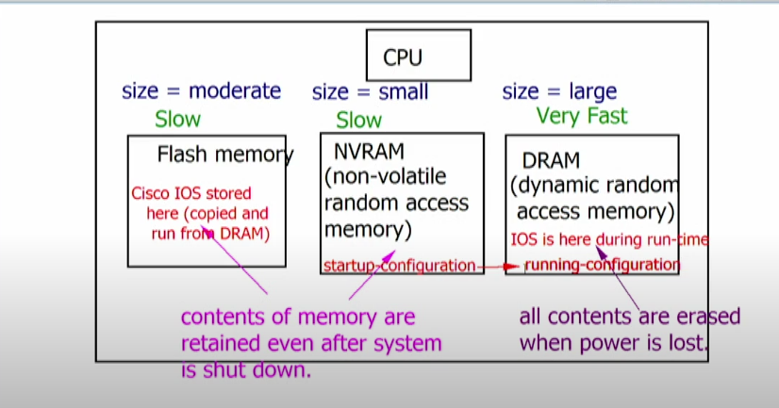
Memory types

Slide 5
Accessing Device via CLI
» Basically, two methods of configuring router/switch
• CLI (command-line interface)
• GUI (graphical user interface)
» Console port is used for initial configuration
» Prerequisites
• Console cable
• Terminal emulator

Slide 6
Accessing Device via CLI
» Connect console cable into the “console” port of a Cisco device
» Open terminal emulator software like Putty or SecureCRT
» Choose serial option with default baud rate, such as 9600

Slide 7
IOS Command Structure
» IOS has a command hierarchy
• Router> - User (or EXEC) mode
• Router# - Privileged EXEC (or Enable) mode
• Configuration modes Router(config)# - Global Configuration Mode
Router(config-if)# - Interface Configuration Mode
Router(config-router)# - Router Configuration Mode
• Usage of Exit, End, Ctrl-Z

Slide 8
Initial Configuration Commands
» Prevent syslog and event messages from interrupting CLI input
• Router(config-line)# logging synchronous
» Prevent DNS resolution attempt for mis-typed commands • Router(config)# no ip domain-lookup
» Configure descriptive device name
• Router(config)# hostname Lab-1-Rtr

Slide 9
Initial Configuration Commands
» Configure informative banner •
Router(config)# banner motd
» Add IPv4 address to an interface
• Router(config-if)#ip address <address><mask>
• Router(config-if)# no shutdown

Slide 10
Monitoring Memory and Images
» Display current IOS version running
• Router# show version
» Display all memory locations and file names
• Router# dir all
» Display saved, startup configuration file
• Router# show startup-config
» Display current running configuration
• Router# show running-config

Slide 11
Saving and Deleting Configurations
» Save current Running Configuration
Router# copy running-config startup-config
Or…
Router# write memory
» Setting a router back to factory defaults
• Step-1: Delete startup configuration
Router# erase startup-config
Or…
Router# write erase
• Step-2: Reload the router
Router# reload

Slide 12
Securing Device Access
» Configuring enable password
• Switch(config)# enable password <password>
OR
• Switch(config)# enable secret <password>
» Configuring console password
• Switch(config)# line console 0
• Switch(config-line)# password <password

Slide 13
Securing Cisco Devices
» Configuring Telnet password
• Switch(config)# line vty 0 4
• Switch(config-line)# password <password>
• Switch(config-line)# login
OR
• Switch(config)# username <username> privilege 15 password <password>
• Switch(config-line)# login local

